Slide 1
Chapter 1
How to get started with Visual Studio

Slide 2
Objectives (part 1)
Applied
Use Visual Studio to perform any of these operations:
Open and close an existing C# project or solution
Display the Form Designer for each of the forms in a project
Display the Code Editor for each of the forms in a project
Use the Solution Explorer to review the files in a project
Open, hide, and adjust the windows for a project
Build and run a project
Knowledge
Describe the main difference between a desktop application and a web application.
Name three platforms you can use to develop Windows desktop applications with .NET.

Slide 3
Objectives (part 2)
Name two platforms you can use to develop web applications with .NET.
Name three programming languages that you can use to develop .NET applications.
Distinguish between .NET Framework and .NET Core.
Describe the two main components of .NET.
In general terms, describe the C# compiler, Microsoft Intermediate Language, the assembly, and the Common Language Runtime.
Describe the use of each of these windows in the Visual Studio IDE: Form Designer, Code Editor, and Solution Explorer.
In general terms, describe how to use Visual Studio to target a version of .NET.

Slide 4

A Windows desktop application

Slide 5
Three platforms for developing Windows desktop applications with .NET
Windows Forms (WinForms)
Windows Presentation Framework (WPF)
Universal Windows Platform (UWP)

Slide 6
Two platforms for developing web applications with .NET
ASP.NET Web Forms
ASP.NET Core MVC

Slide 7
Visual Studio 2019 editions
Community Edition
Professional Edition
Enterprise Edition
.NET programming languages
C#
Visual Basic
F#

Slide 8
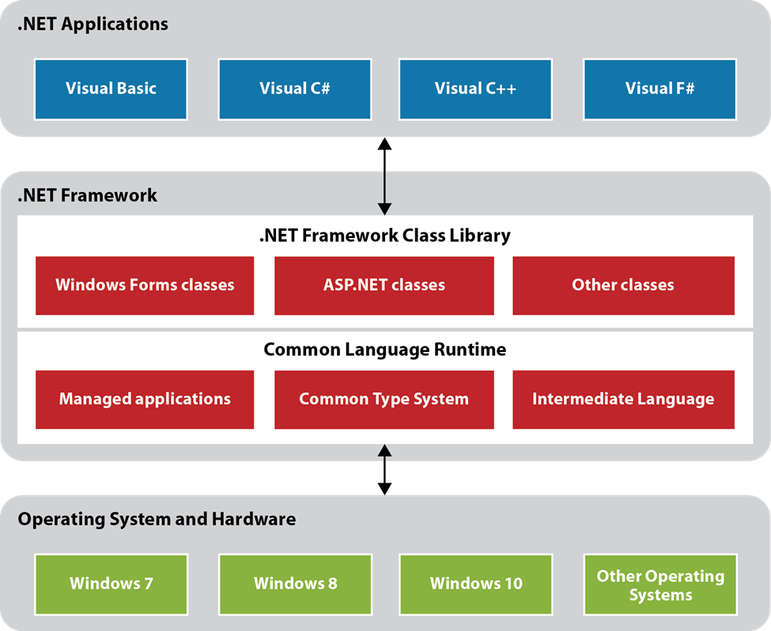
The .NET Framework and .NET Core

Slide 9
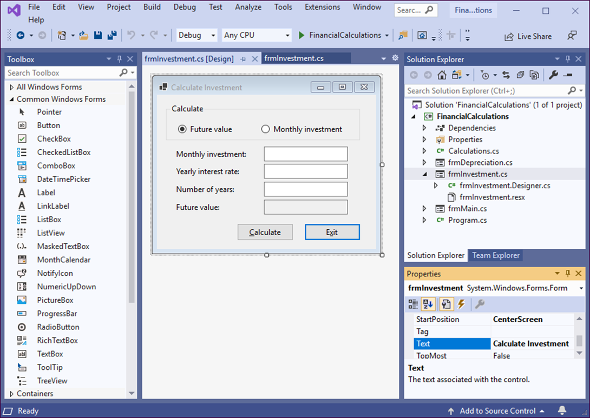
The Visual Studio IDE

Slide 10
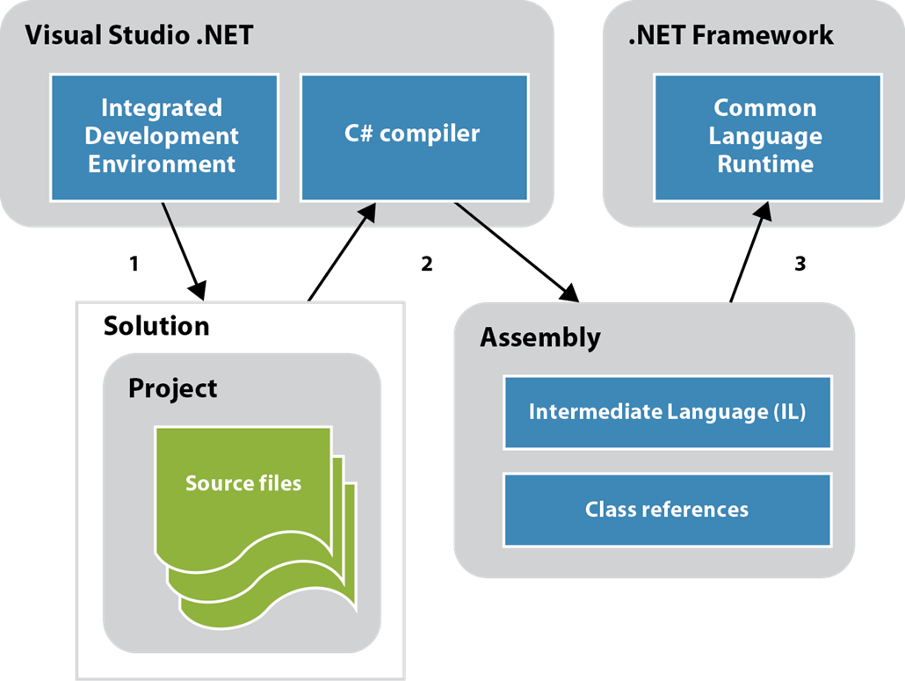
How a C# application is compiled and run

Slide 11
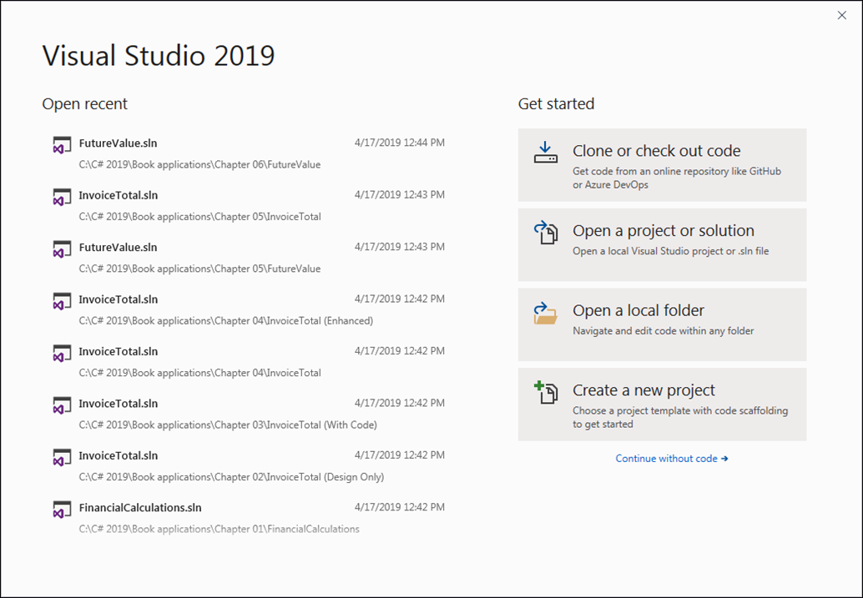
The Start window that’s displayed when you start Visual Studio

Slide 12
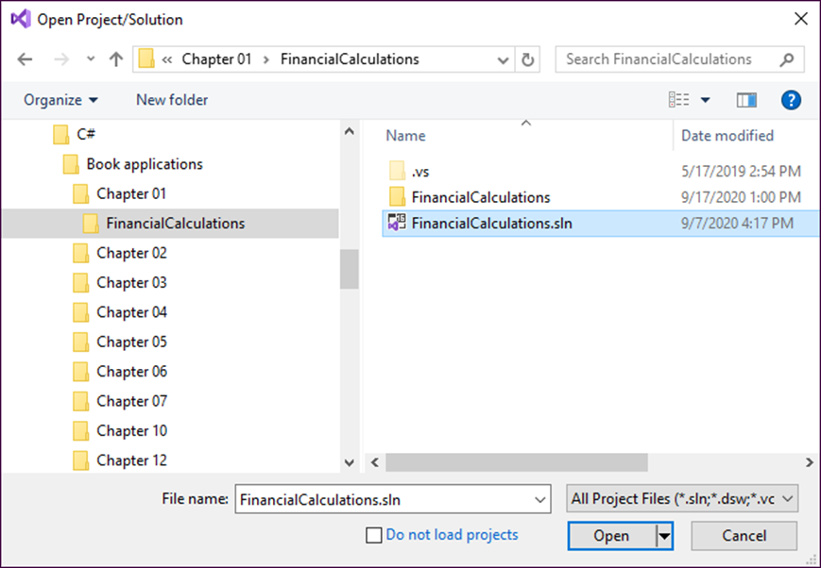
The Open Project/Solution dialog box

Slide 13
Project and solution concepts
Every C# project has a project file with an extension of .csproj that keeps track of the files that make up the project and records various settings for the project.
Every solution has a solution file with an extension of .sln that keeps track of the projects that make up the solution.
When you open a project file, Visual Studio opens the solution that contains the project. And when you open a solution file, Visual Studio automatically opens all the projects contained in the solution.
Sometimes the project and solution files are stored in the same directory. Sometimes the project file is stored in a subdirectory of the directory that contains the solution file.

Slide 14
How to open a project
To open an existing project, use the File→Open→ Project/Solution command. Then, use the controls in the resulting dialog box to locate and select the project or solution you want to open.
After you’ve worked on one or more projects, their names will be listed in the File→Recent Projects and Solutions submenu. Then, you can click on a project or solution name to open it.
You can also use the links in the Start window to open a project.
How to close a project
Use the File→Close Solution command.

Slide 15
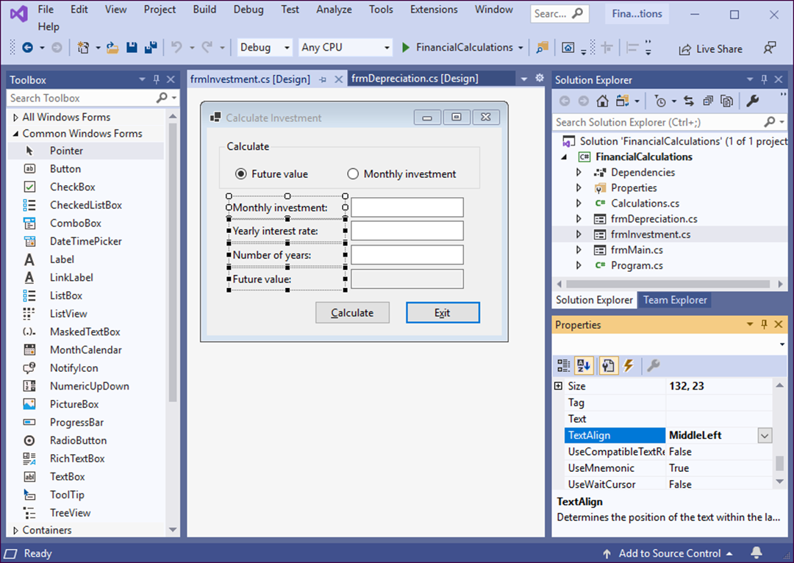
Visual Studio with the Form Designer displayed

Slide 16
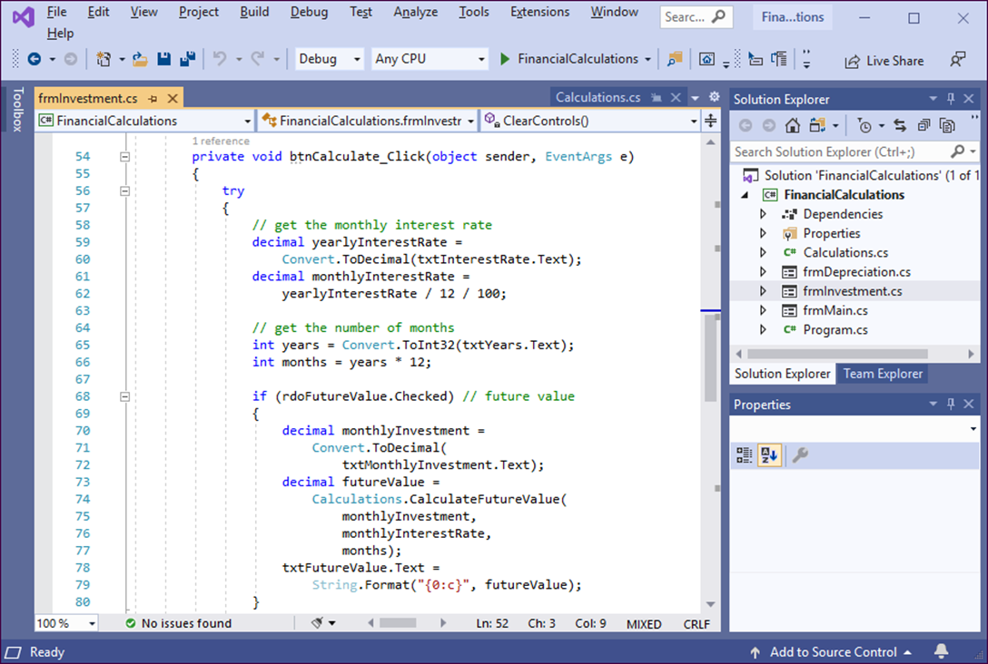
Visual Studio with the Code Editor displayed

Slide 17
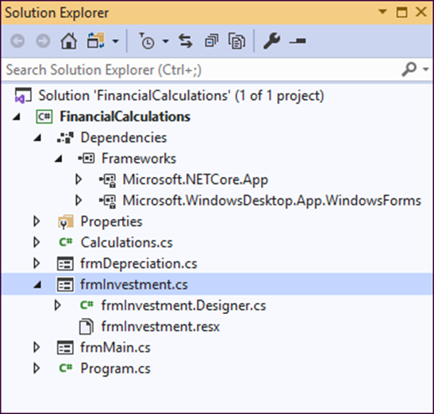
The Solution Explorer

Slide 18
Project files (part 1)
The Solution Explorer uses different icons to distinguish between source code files that define forms and source code files that don’t.
Each form is defined by two C# source files where each file contains a partial class. The file with the cs extension contains the code that’s entered by the programmer, and the file with the Designer.cs extension contains the code that’s generated when the programmer works with the Form Designer. When the project is compiled, these partial classes are combined into a single class that determines the appearance and operation of the form.
A source code file that doesn’t define a form is usually stored in a single C# source file that contains a single class.

Slide 19
Project files (part 2)
When you create a new application, Visual Studio creates the Program.cs file automatically. For a Windows Forms application, this file contains the C# code that starts the application and runs the first form in the application.
When you create a new Windows Forms application for .NET Core, Visual Studio automatically adds two frameworks under the Dependencies group item. These frameworks contain assemblies for the namespaces that contain the classes available to the project.

Slide 20
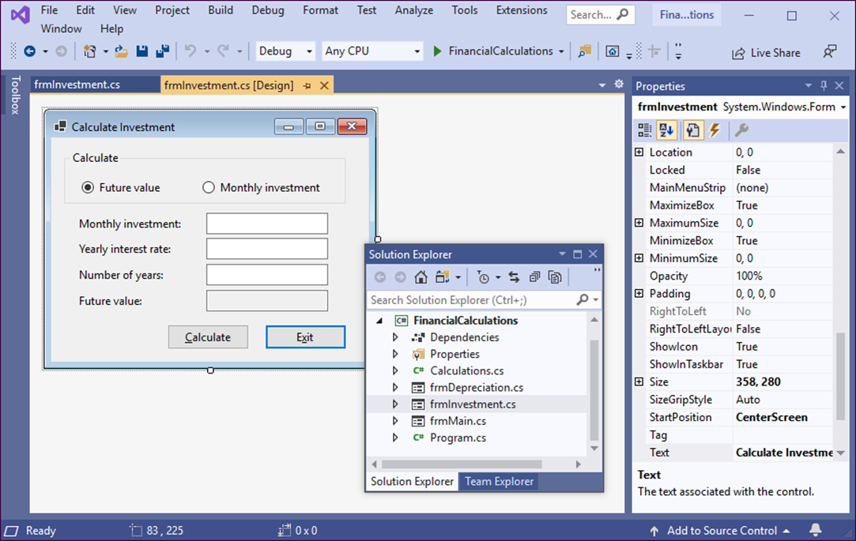
Two floating windows, a hidden window, and a pinned window

Slide 21
How to rearrange windows (part 1)
To close a window, click its Close button. To redisplay it, click its button in the Standard toolbar (if one is available) or select it from the View menu.
To undock a docked window so it floats on the screen, drag it by its title bar away from the edge of the application window or double-click its title bar.
To dock a floating window, drag it by its title bar onto one of the positioning arrows that become available. Or, hold down the Ctrl key and then double-click its title bar to return it to its previous docked location.
To hide a docked window, click its Auto Hide button. Then, the window is displayed as a tab at the edge of the screen, and you can display it by clicking on the tab. To change it back, display it and then click the Auto Hide button.

Slide 22
How to rearrange windows (part 2)
To size a window, place the mouse pointer over an edge or a corner of the window and drag it.
To display a window in a group of tabbed windows, click on its tab. To close a tabbed window, click on its Close button.
If you dock, undock, hide, or unhide a tabbed window, all the windows in the group are docked, undocked, hidden, or unhidden.
To pin a window at the left side of the main window, click the Toggle Pin Status button. To unpin the window, click this button again.
You can also use the commands in the Window menu to work with windows. For example, you can use the Reset Window Layout command to return the windows to their default layout. You can also save, apply, and manage custom layouts.

Slide 23
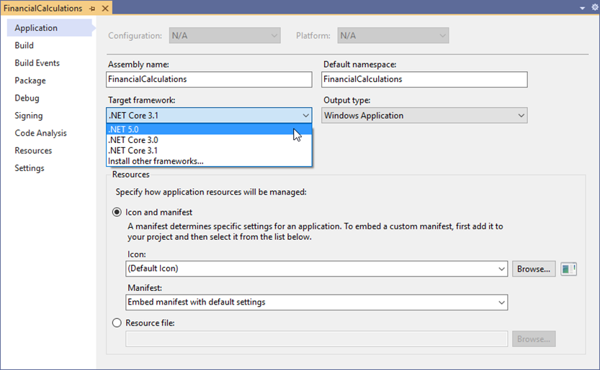
The Project Properties window
Note
To change the target framework to a newer version of .NET Core, the newer version must be installed on your system. If it isn’t, you can use the Visual Studio Installer program to install it as described in appendix A.

Slide 24
How the .NET version corresponds to the default C# version
Target framework Default C# version
.NET 5.x C# 9.0
.NET Core 3.x C# 8.0
.NET Framework (all) C# 7.3
Note
The target framework determines the default C# version. If necessary, you can manually change the default C# version for a project. However, choosing a version newer than the default is not recommended since it can cause errors that are difficult to find and fix.

Slide 25

The form that’s displayed when the Financial Calculations project is run

Slide 26
How to build a project without running it
Use the Build→Build Solution command. Or, press F6. This builds the Intermediate Language for the project and saves it in an assembly.
How to run a project
Click the Start button in the Standard toolbar. Or, press F5. This runs the project and displays its first form on top of the Visual Studio window.
If the project hasn’t already been built, the project is first built and then run. As a result, it isn’t necessary to use the Build command before you run the program.

Slide 27
Objectives (part 1)
Applied
Use Visual Studio to perform any of these operations:
Open and close an existing C# project or solution
Display the Form Designer for each of the forms in a project
Display the Code Editor for each of the forms in a project
Use the Solution Explorer to review the files in a project
Open, hide, and adjust the windows for a project
Build and run a project
Knowledge
Describe the main difference between a desktop application and a web application.
Name three platforms you can use to develop Windows desktop applications with .NET.

Slide 28
Objectives (part 2)
Name two platforms you can use to develop web applications with .NET.
Name three programming languages that you can use to develop .NET applications.
Distinguish between .NET Framework and .NET Core.
Describe the two main components of .NET.
In general terms, describe the C# compiler, Microsoft Intermediate Language, the assembly, and the Common Language Runtime.
Describe the use of each of these windows in the Visual Studio IDE: Form Designer, Code Editor, and Solution Explorer.
In general terms, describe how to use Visual Studio to target a version of .NET.

